Slide 1
Advanced Topics
SE401: Software Quality Assurance and Testing

Slide 2
Outline
Web Testing
Mobile Testing

Slide 3
Web Testing

Slide 4
Outline
Web-site vs. Web Application
Testing Web Applications
Web Testing Types
Test Automation

Slide 5
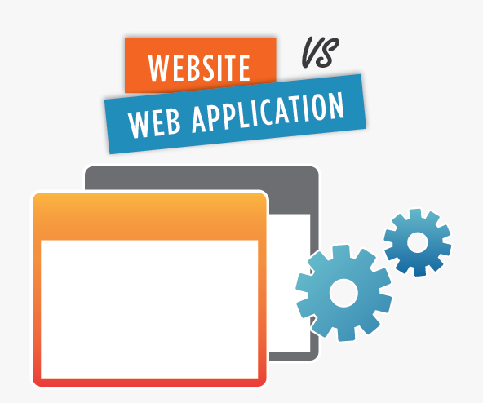
Website vs. Web Application
A website is a collection of related web pages, including multimedia content, typically identified with a common domain name, and published on at least one web server. Notable examples are wikipedia.org.
So .. A website is informational

Slide 6
Website vs. Web Application
A web application: is a client–server computer program which the client (including the user interface and client-side logic) runs in a web browser. Common web applications include webmail, online retail sales, and online auction.
So .. a web application is interactive

Slide 7
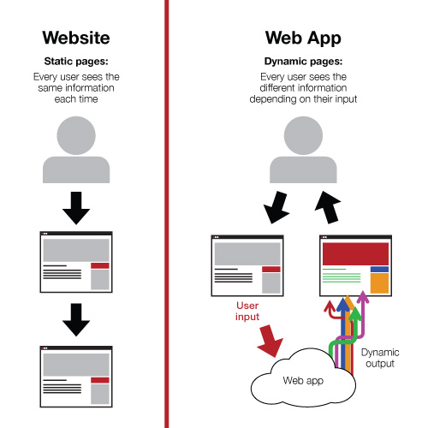
So ..

Slide 8
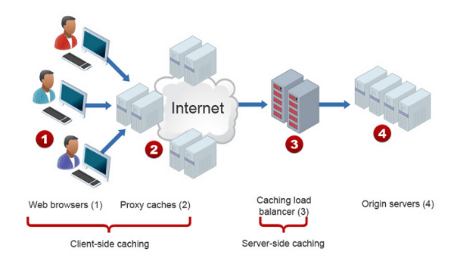
What is Web Testing
Web testing is a software testing practice to test the websites or web applications for potential bugs.
A web-based system needs to be checked completely from end-to-end before it goes live for end users.

Slide 9
What is Web Testing
It is performed before making the web application alive.
By performing web testing, we can make sure that the website or web application is functioning properly and can be accepted by real-time users.

Slide 10

Why Web Testing is Challenging?
Web based systems and applications interoperate with many different:
Operating systems
Browsers
Hardware platforms
Communications protocols
The search for errors represents a significant challenge
New technologies make web applications rich, but they become more difficult to test.

Slide 11
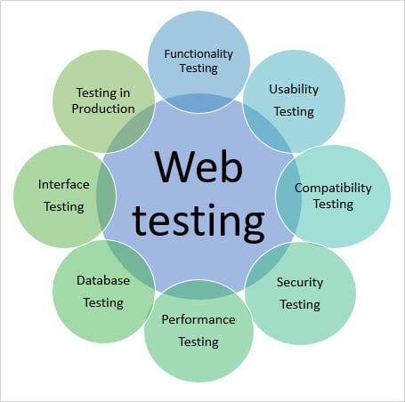
Web Testing Types
Some or all the following testing types may be performed depending on the web testing requirements:
1. Functionality Testing
2. Usability testing
3. Interface testing
4. Compatibility testing
5. Performance testing
6. Security testing

Slide 12
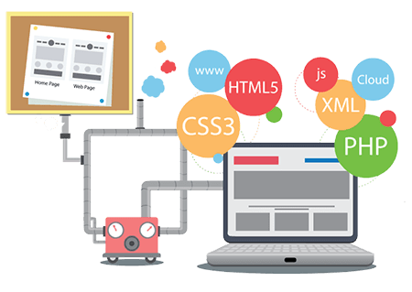
1. Functionality Testing
Testing the features and operational behavior of a web application to ensure they correspond to its specifications.
Test for – all the links in web pages, database connection, forms used for submitting or getting information from the user in the web pages, Cookie testing, and HTML and CSS files etc.

Slide 13
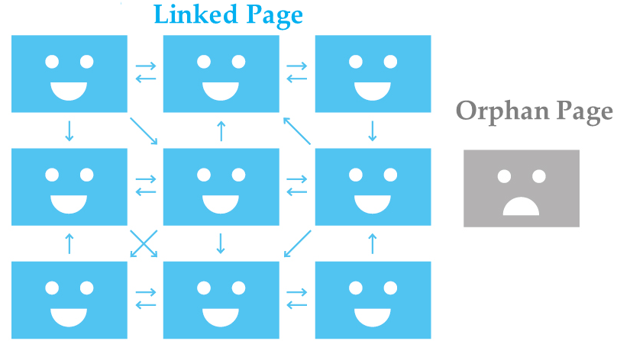
1. Functionality Testing
1.1 Check all the links:
Test the external links from all the pages to a specific domain under test.
Test all internal links between web application pages
Test links used to send email to admin or other users from web pages.
Test to check if there are any orphan pages.
Finally, link checking includes, check for broken links in all above-mentioned links.

Slide 14
1. Functionality Testing
1.2 Test forms on all pages: Forms are part of any website that is used for receiving information from users and to interact with them.
So what should be checked in these forms?
First, check all the validations on each field.
Check for default values of the fields.
Wrong inputs to the fields in the forms.

Slide 15
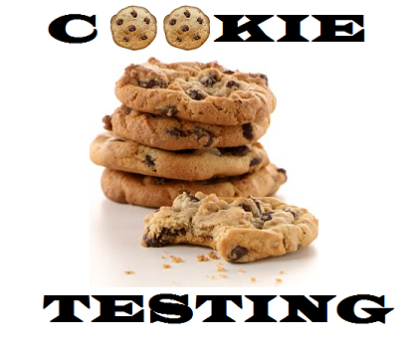
1. Functionality Testing
1.3 Test Cookies: cookies are small files that are stored on a user's computer. They hold data specific to a particular client and website, and can be accessed either by the web server or the client computer.
Test the application by enabling or disabling cookies in a browser
Test if cookies are encrypted before they are written to the user machine
Test if cookies are deleted when they are not needed anymore.

Slide 16
1. Functionality Testing
1.4 Test HTML and CSS:
Checking for syntax errors
Check if the site is crawlable by different search engines.
Readable color scheme and fonts
Standards compliance (i.e. such as W3C and ISO)

Slide 17

1. Functionality Testing
1.5 Database Testing:
Data validity testing: test if any errors are shown while executing queries
Data integrity testing: check for errors while you edit, delete, modify data in database
Check response time of queries.
Check if all the database queries are executing correctly, data is retrieved and updated correctly.
Check if data retrieved from database is shown accurately in the web application .

Slide 18
1. Functionality Testing
Examples of Functionality Test Scenarios:
Test all the mandatory fields should be validated.
Test the system should not display the error message for optional fields.
Test the numeric fields should not accept the alphabets and proper error message should display.
Test the pop-up message ("This field is limited to 500 characters") should display if the data reaches the maximum size of the field.
Test that a confirmation message should display for update and delete operations.
Test all input fields for special characters.
Test the functionality of the buttons available, … etc.

Slide 19
2. Usability Testing
Usability testing is the process by which the human-computer interaction characteristics of a system are measured, and weaknesses are identified for correction.
In usability testing:
Check if the application is user-friendly (general appearance and interaction)
Check the flow of the system and that it is easy to understand and learn by the user
Basically, system navigation and content are checked in usability testing

Slide 20
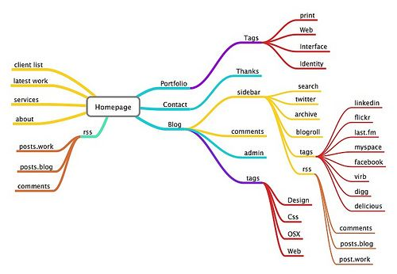
2. Usability Testing
2.1 Navigation:
Navigation means how a user surfs the web pages, different controls like buttons, boxes or how the user uses the links on the pages to surf different pages.
Menus, buttons or links to different pages on your site should be easily visible and consistent on all webpages
The web application should be easy to use and navigate

Slide 21
2. Usability Testing
2.2 Content:
Content should be logical and easy to understand. Check for spelling errors. Usage of dark colors annoys the users and should not be used in the site theme.
You can follow some standard colors that are used for web page and content building.
Content should be meaningful. All the anchor text links should be working properly. Images should be placed properly with proper sizes.
These are some of the basic important standards that should be followed in web development.

Slide 22
2. Usability Testing
Examples of Usability Test Scenarios:
All fonts should be same as per the requirements.
All the text should be properly aligned.
Tool tip text should be there for every field.
All the buttons should be in a standard format and size.
Home link should be there on every single page.
Confirmation message should be displayed for any kind of interaction.
Check the site on different resolutions (640 x 480, 600x800 etc.?)
Check the end user can run the system without frustration.
Scroll bar should appear only if required.
All fields and buttons should be accessible by keyboard shortcuts and the user should be able to perform all operations by using keyboard… etc.

Slide 23
3. Interface Testing
The main layers in a web application are:
Web server
Application server
Database server
Check if all interactions between these layers are executed properly
Interactions between different pages in the applications are also checked

Slide 24
4. Compatibility Testing
Compatibility testing is used to determine if your software is compatible with other elements of a system with which it should operate, e.g. Browsers, Operating Systems, or hardware.
The purpose of Compatibility testing is to evaluate how well software performs under different browsers, operating systems, hardware or software.

Slide 25
4. Compatibility Testing
Examples of Compatibility Test Scenarios:
Test the web application in different browsers (IE, Firefox, Chrome, Safari and Opera) and ensure the website is displaying properly.
Test the HTML version being used is compatible with appropriate browser versions.
Test the images display correctly in different browsers.
Test the fonts are usable in different browsers.
Test the java script code is usable in different browsers.
Test the Animated GIF's across different browsers.
Etc..

Slide 26
5. Security Testing
Security Testing is vital for web applications that store sensitive customer information like credit cards, ids, passwords, etc.
Testing activities will include:
Test unauthorized access to secure pages should not be permitted
Restricted files should not be downloadable without appropriate access
Check sessions are automatically killed after prolonged user inactivity
On use of SSL certificates, website should re-direct to encrypted SSL pages.

Slide 27
5. Security Testing
Examples of Security Test Scenarios:
Verify the web page which contains important data like password, credit card numbers, secret answers for security question etc should be submitted via HTTPS (SSL).
Verify the important information like password, credit card numbers etc should display in encrypted format.
Verify password rules are implemented on all authentication pages like Registration, forgot password, change password.
Verify if the user is logged out from the system or user session was expired, the user should not be able to navigate the site.
Verify the user account gets locked out if the user is entering the wrong password several times.
Verify the user roles and their rights. For Example The requestor should not be able to access the admin page.
Etc..

Slide 28
6. Performance Testing
This will ensure your site works under all loads. Testing activities will include but not limited to:
Website application response times at different connection speeds
Load test your web application to determine its behavior under normal and peak loads
Stress test your web site to determine its break point when pushed to beyond normal loads at peak time.
Test if a crash occurs due to peak load, how does the site recover from such an event

Slide 29
6. Performance Testing
Examples of Performance Test Scenarios:
To determine the performance, stability and scalability of an application under different load conditions.
To determine if the current architecture can support the application at peak user levels.
To determine which configuration provides the best performance level.
To identify application and infrastructure bottlenecks.
To determine if the new version of the software adversely had an impact on response time.
To evaluate product and/or hardware to determine if it can handle projected load volumes.
Etc..

Slide 30
Website Test Automation
Automation testing helps to relieve the bulk of tedious and repetitive human tasks.
With the right test automation framework or tool, QAs can automate repetitive browser actions like interacting with web elements or filling out long HTML forms.
Automating tests help teams save time and effort, get faster and accurate results, increase software efficiency, and focus on innovation.

Slide 31
Benefits of Website Test Automation
Faster feedback
Improved test efficiency
Reduced expenses
Reusability of test cases
Faster time to market

Slide 32
Selenium
Selenium is open source testing tool for web applications. Any web application can be testing on web browsers with this automation testing tool.
Selenium tool can test only web application, it is not useful for mobile or desktop applications.
Test scripts can be written in Java, Python, C#, PHP, Ruby, Perl & .Net
Tests can be carried out in Windows, Mac or Linux
Tests can be carried out using Mozilla Firefox, Internet Explorer, Google Chrome, Safari or Opera
It can be integrated with tools like JUnit for managing test cases and generating reports

Slide 33
Setup Selenium
Eclipse IDE (Users can use other IDEs too)
Selenium Client and language WebDiver bindings
Configuring Selenium WebDriver with Eclipse

Slide 34
Summary
Web-site vs. Web Application
Testing Web Applications
Web Testing Types
Test Automation

Slide 35
Mobile Testing

Slide 36
Outline
What is a Mobile Application?
Mobile Testing vs. Mobile Application Testing
Why Perform Mobile Application Testing
Challenges in Mobile Application Testing
Types of Mobile Application Testing

Slide 37

Mobile Application
A mobile application is a software application developed specifically for use on small, wireless, handheld mobile devices such as smart-phones and tablets.
Mobile apps are available through application distribution platforms which are typically operated by the owner of the mobile operating system, such as the App Store (iOS) or Google Play Store.

Slide 38
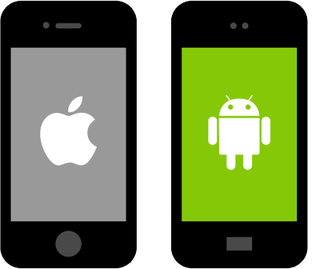
Main Mobile Phone Platforms

Slide 39
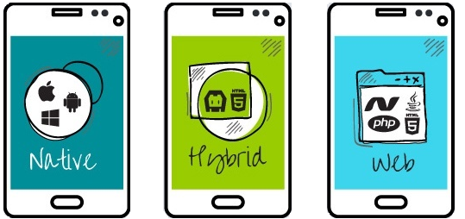
Mobile Application
Types of Mobile Applications:
Native Applications:
Mobile Web Applications
Hybrid applications

Slide 40

Mobile Application
Native Apps:
Are installed through different mobile platforms stores (Google Play Store or Apple’s app store).
Are Platform specific
Offers fast, most reliable and most responsive experience to the users.

Slide 41
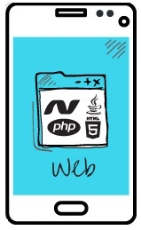
Mobile Application
Mobile Web Apps:
Are server-side apps to access website/s on mobile using different browsers like Chrome, Firefox by connecting to a mobile network or wireless network like Wi-Fi.
Developing web apps is simple and quicker than Native apps
Slower and less intuitive comparted to Native apps.

Slide 42

Mobile Application
Hybrid Apps:
Are combinations of native app and web app. (You install it like a native app, but it’s a web app on the inside).
They run on devices or offline and are written using web technologies like HTML5 and CSS.

Slide 43

Mobile vs Mobile Application Testing
Mobile Testing:
Testing the mobile device (the hardware) including the internal processors, internal hardware, screen sizes, resolution, space or memory, camera, radio, Bluetooth, WIFI etc.
Mobile Application Testing:
Testing the applications (software) that work on mobile devices and their functionality.

Slide 44

Mobile Application Testing
Mobile application testing is a process by which application software developed for handheld mobile devices is tested for its functionality, usability and consistency.
Mobile application testing can be an automated or manual type of testing.

Slide 45
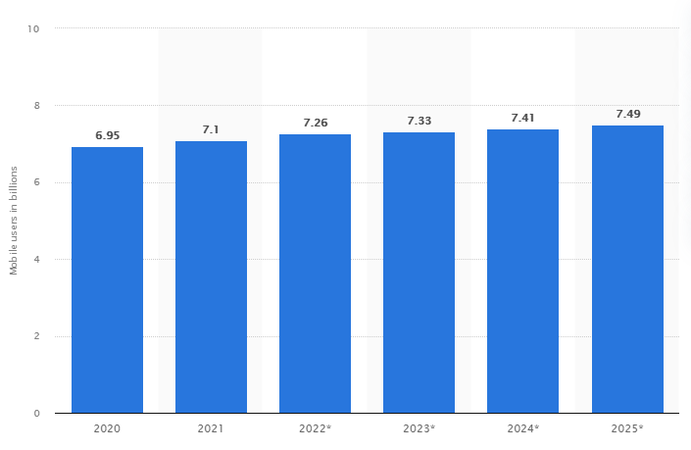
Why Testing Mobile Apps is Important
Forecast number of mobile users worldwide from 2020 to 2025

Slide 46
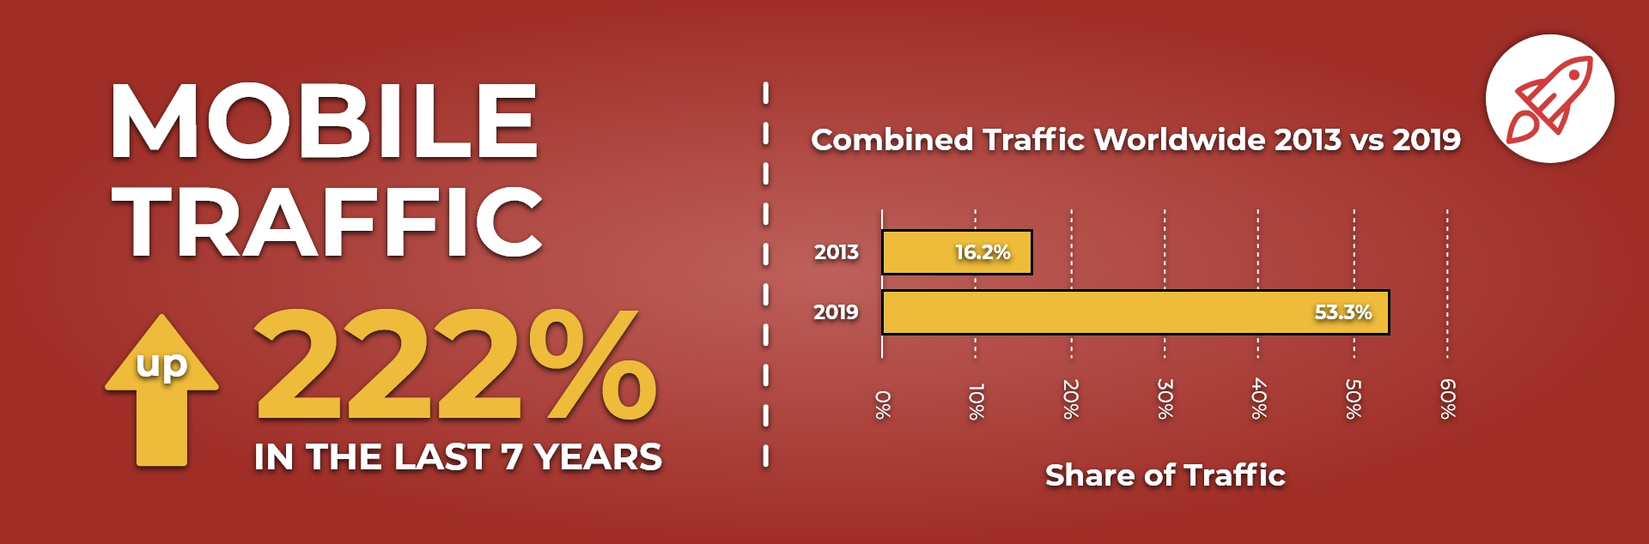
Why Testing Mobile Apps is Important

Slide 47

Challenges in Mobile App testing
Issues that make testing mobile applications more challenging:
Variety of mobile devices available in the market (i.e. HTC, iPhone, Samsung, etc.. )
Diverse mobile operating platforms used (iOS, Android)
Different network service providers
Different input methods
Hardware compatibility

Slide 48
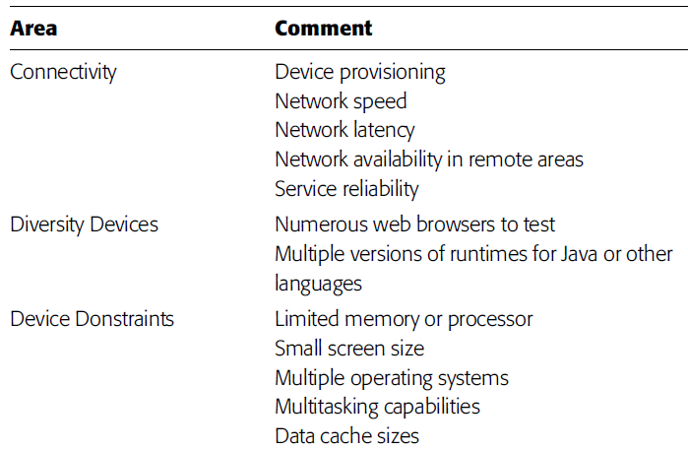
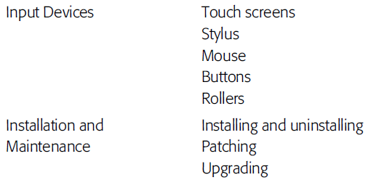
Mobile Environment Test Design Considerations

Slide 49
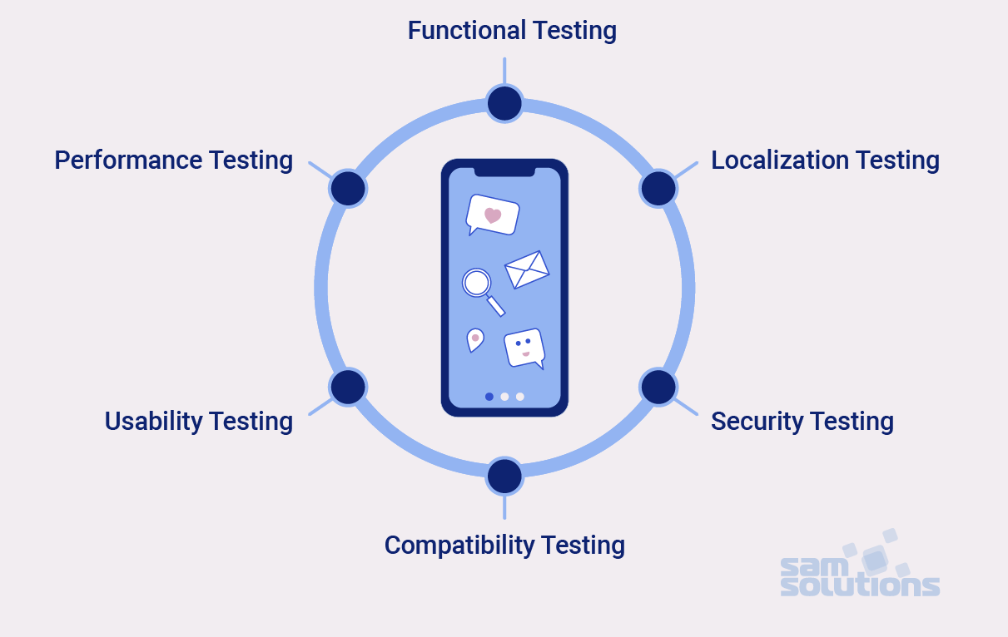
Major Types of Mobile Apps testing

Slide 50
Functional Testing
Consists of
testing user interactions
testing the transactions
Relevant factors:
Type of application (banking, gaming, social or business)
Target audience type (consumer, enterprise, education)
Distribution channel (e.g. Apple App Store, Google play, direct distribution)

Slide 51
Functional Testing Scenarios (1)
Mandatory fields are working as required
Mandatory fields are displayed distinctively from the non-mandatory fields
The application works as per as requirement whenever the application starts/stops
The application goes into minimized mode whenever there is an incoming phone call
The phone is able to store, process and receive SMS whenever the app is running
The device is able to perform required multitasking requirements whenever it is necessary to do so

Slide 52
Functional Testing Scenarios (2)
The application allows necessary social network options such as sharing, posting and navigation etc.
The application supports any payment gateway transaction such as Visa, Mastercard, Paypal etc.
The page scrolling scenarios are being enabled in the application as necessary
The navigation between relevant modules in the application are as per the requirement
The truncation errors are absolutely to an affordable limit
The user receives an appropriate error message like “Network error. Please try after some time” whenever there is any network error

Slide 53
Functional Testing Scenarios (3)
Allows other applications to perform satisfactorily, and it does not eat into the memory of the other applications
Resumes at the last operation in case of a hard reboot or system crash
Installation can be done smoothly provided the user has the necessary resources and it does not lead to any significant errors
Performs auto start facility according to the requirements
Performs according to the requirement in all versions of Mobile that is 2g, 3g,4g and 5g
Regression Testing to uncover new software bugs in existing areas of a system after changes have been made to them.
Provides an available user guide for those who are not familiar to the app

Slide 54
Performance Testing
Fundamental objective is to ensure that the application performs acceptably under certain performance requirements such as access by a huge number of users or the removal of a key infrastructure part like a database server.

Slide 55
Performance Testing Scenarios (1)
Performs as per the requirement under different load conditions
The current network coverage is able to support the application at peak, average and minimum user levels
The existing client-server configuration setup provides the required optimum performance level
Identify the various application and infrastructure bottlenecks which prevent the application to perform at the required acceptability levels
Validate whether the response time of the application is as per as the requirements

Slide 56
Performance Testing Scenarios (2)
Evaluate product and/or hardware to determine if it can handle projected load volumes
Evaluate whether the battery life can support the application to perform under projected load volumes
Validate application performance when network is changed to WIFI from 3G/4G/5G or vice versa
Validate that the battery consumption, memory leaks, resources like GPS, Camera performance is well within required guidelines

Slide 57
Performance Testing Scenarios (3)
Validate the application longevity whenever the user load is rigorous
Validate the network performance while moving around with the device
Validate the application performance when only intermittent phases of connectivity is required

Slide 58
Security Testing
The fundamental objective of security testing is to ensure that the application’s data and networking security requirements are met as per guidelines

Slide 59
Security Testing Scenarios (1)
Able to withstand any brute force attack which is an automated process of trial and error used to guess a person’s username, password or credit-card number
Not permitting an attacker to access sensitive content or functionality without proper authentication
Has a strong password protection system and it does not permit an attacker to obtain, change or recover another user’s password
Does not suffer from insufficient session expiration
Identify the dynamic dependencies and take measures to prevent any attacker for accessing these vulnerabilities

Slide 60
Security Testing Scenarios (2)
Prevent from SQL injection related attacks
Identify and recover from any unmanaged code scenarios
Certificates are validated, does the application implement Certificate Pinning or not
Protect the application and the network from the denial of service attacks
Analyze the data storage and data validation requirements
Enable the session management for preventing unauthorized users to access unsolicited information

Slide 61
Security Testing Scenarios (3)
Check if any cryptography code is broken and ensure that it is repaired
Validate whether the business logic implementation is secured and not vulnerable to any attack from outside
Analyze file system interactions, determine any vulnerability and correct these problems
Validate the protocol handlers for example trying to reconfigure the default landing page for the application using a malicious iframe
Protect against malicious client side injections
Protect against malicious runtime injections

Slide 62
Security Testing Scenarios (4)
Investigate file caching and prevent any malicious possibilities from the same
Prevent from insecure data storage in the keyboard cache of the applications
Investigate cookies and preventing any malicious deeds from the cookies
Provide regular audits for data protection analysis
Investigate custom created files and preventing any malicious deeds from the custom created files
Prevent from buffer overflows and memory corruption cases
Analyze different data streams and preventing any vulnerabilities from these

Slide 63
Usability Testing
The usability testing process of the Mobile application is performed to have a quick and easy step application with less functionality than a slow and difficult application with many features
The main objective is to ensure that we end up having an easy-to-use, intuitive and similar to industry-accepted interfaces which are widely used

Slide 64
Usability Testing Scenarios (1)
Buttons should have the required size and be suitable to big fingers
Buttons are placed in the same section of the screen to avoid confusion to the end users
Icons are natural and consistent with the application
Buttons, which have the same function should also have the same color
Validation for the tapping zoom-in and zoom-out facilities should be enabled
Keyboard input can be minimized in an appropriate manner

Slide 65
Usability Testing Scenarios (2)
Application provides a method for going back or undoing an action, on touching the wrong item, within an acceptable duration
Contextual menus are not overloaded because it has to be used quickly
Text is kept simple and clear to be visible to the users
Short sentences and paragraphs are readable to the end users
Font size is big enough to be readable and not too big or too small
Application prompts the user whenever the user starts downloading a large amount of data which may be not conducive for the application performance

Slide 66
Usability Testing Scenarios (3)
Closing of the application is performed from different states and verify if it re-opens in the same state
All strings are converted into appropriate languages whenever a language translation facility is available
Application items are always synchronized according to the user actions
End user is provided with a user manual which helps the end user to understand and operate the application who may be not familiar with the application’s proceedings

Slide 67
Compatibility Testing
Compatibility testing on mobile devices is performed to ensure that since mobile devices have different size, resolution, screen, version and hardware so the application should be tested across all the devices to ensure that the application works as desired

Slide 68
Compatibility Testing Scenarios
User Interface of the application is as per the screen size of the device, no text/control is partially invisible or inaccessible
Text is readable for all users for the application
Call/alarm functionality is enabled whenever the application is running. The application is minimized or suspended on the event of a call and then whenever the call stops the application is resumed

Slide 69
Recoverability Testing Scenarios
Crash recovery and transaction interruptions
Validation of the effective application recovery situation post unexpected interruption/crash scenarios
Verification of how the application handles a transaction during a power failure (i.e. Battery dies or a sudden manual shutdown of the device)
Validation of the process where the connection is suspended, the system needs to re-establish for recovering the data directly affected by the suspended connection

Slide 70
Other Testing Scenarios (1)
Installation testing
whether the application can be installed in a reasonable amount of time and with required criterion
Uninstallation testing
whether the application can be uninstalled in a reasonable amount of time and with required criterion
Network test cases
validation of whether the network is performing under required load or not, whether the network is able to support all the necessary applications during the testing procedures

Slide 71
Other Testing Scenarios (2)
Continued keypad entry during interrupts and other times like network issues
Methods which deal with exiting the application
Charger effect while an application is running in the background
Low battery and high performance demand
Removal of battery while an application is being performed
Consumption of battery by application
Check Application side effects

Slide 72
Manual or Automated Mobile App Testing Tools
Both manual and automated testing are widespread and can provide good results.
The choice should be based on the company’s preferences and capabilities.
Somebody may think that manual testing will be entirely replaced by test automation, but it is not true.
Moreover, there are certain situations when manual control is a better option.

Slide 73
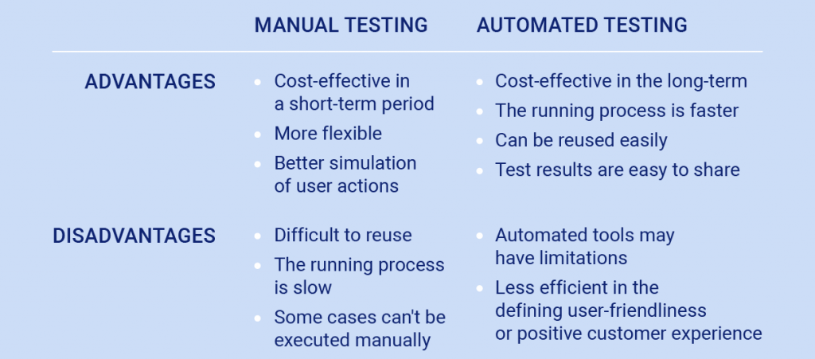
Manual vs Automated Mobile App Testing

Slide 74
Universal Mobile Testing Tools
There are universal testing tools suitable for Android and iOS solutions.
Some examples are:
Eggplant — an industry-leading test automation and monitoring platform.
Ranorex — an automated tool for mobile, web and desktop solutions.
Appium — an open-source test automation framework for mobile native, hybrid and web solutions.
Kobiton — an AI-powered tool for manual and automated testing.
There are also tools specifically used for Android- only or iOS-only apps.
Selendroid — a test automation framework for native or hybrid Android apps.
iOS Driver — an open-source tool for iOS native, hybrid, or mobile web solutions.

Slide 75
Summary
What is a Mobile Application?
Mobile Testing vs. Mobile Application Testing
Why Perform Mobile Application Testing
Challenges in Mobile Application Testing
Types of Mobile Application Testing

